Slide 1
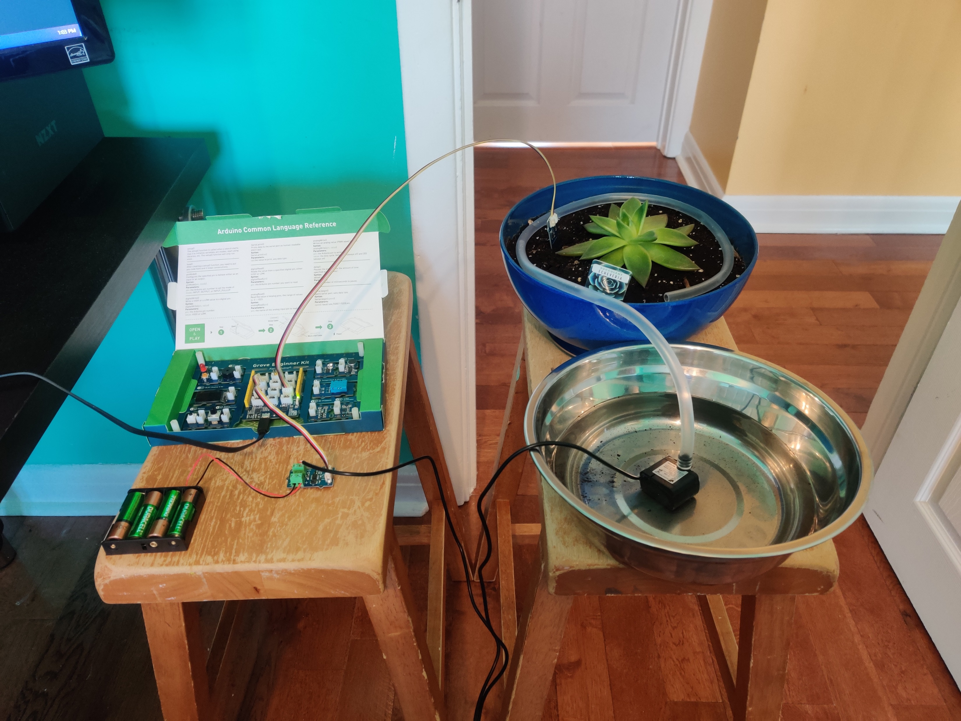
SENSOR
POT
GROVE BOARD
WATER OUTLET
WATER SUPPLY
MOSFET
PUMP
Batteries

